Slide 1

Department Of Computer Science

Slide 2
Software Requirement Specification Renters/Proprietors Coordination Application
Shahzaneer Ahmed
CUI/SP21-BCS-087/ISB
Shayan Zameer
CUI/SP21-BCS-088/ISB
Supervisor:
Mr. Tehseen Riaz Abbasi
Department Of Computer Science
Submission Date: 2, December, 2022

Slide 3
Project Category
The project categories are:
B- Web Application/Web Application based Information System
C- Problem Solving and Artificial Intelligence
E- Smartphone Application

Slide 4
Research Based Project
Yes the Project is R&D based.

Slide 5
Introduction
Recognizing the facial features of person based on their audio notes by a human being who don’t actually know the person make no sense in real life.
There is no way to do so But Artificial Intelligence has made it possible to do so.
The Machine learning and deep learning can be trained on data of all type of people with some mathematical perspectives of voice that uses clustering algorithms and categorize the people in different domains.
The image will not be 100% real but it gives a lot of insights of data which can help us to identify the person.

Slide 6
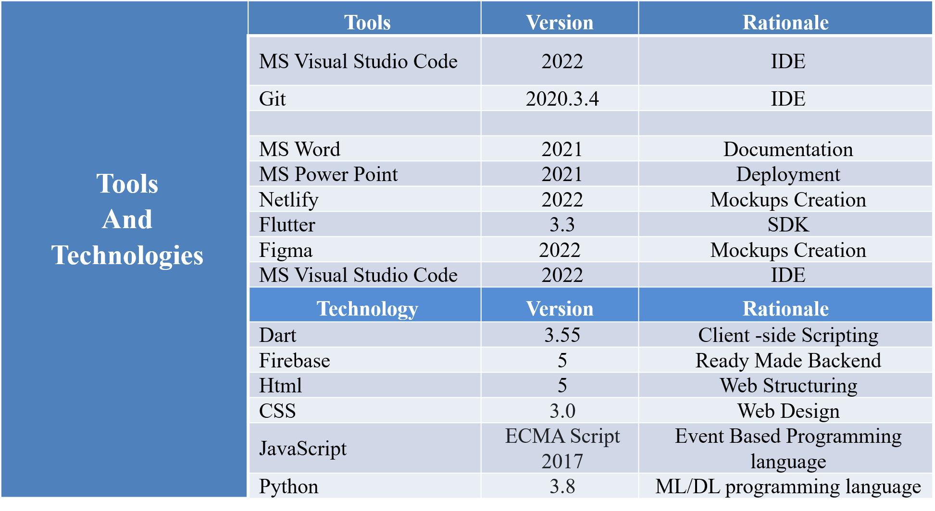
Tools and Technologies
The tools and technologies that will be used in the project are provided in the table below

Slide 7
Scope
The application will be designed to provide coordination among the User and Security Person.
Profile Management: The users will have to register and then sign into the system to use it. His record will be saved against his ID.
Chat bot: There is an intelligent chatbot that will help the user to get started with the application and will guide about usage.
Post-Voice record Management: The user can record voice, add previously existing voice , update it and delete it. It will be analyzed by the ML model.
Vector to Vector Model: The voice is the extracted and converted to the vector model with the help of machine learning and AI.
Vector Model to Vector-Image Model: The generated vector model is taken as input for this module and It is converted to image form using the power of AI.
Help and Support: User’s queries will be resolved through an AI bot and If it is unable to resolve query then user will have option to live chat with the support team.

Slide 8
Scope
Review Module: As the project is R & D based therefore it is not 100% possible for the system to detect the correct insights. Therefore, the system will prompt the user to give his feedback and it will improve itself according to the reviews given by users.
Insights Module: It Opens a page to the insights that are obtained by the voice notes including predicted age, race, nose type, facial features details, etc.

Slide 9
Modules
The modules of the project are listed below:
Module 1: Profile Management
Module 2: Place Voice Record
Module 3: Sound to Face Vector Model
Module 4: Face-Vector to Face-Image Model
Module 5: Image View Customization
Module 6: Features Enhancer.
Module 7: Insight Panel
Module 8: Feedback panel
Module 9: Help and Support

Slide 10
Software Process Methodology
The software process methodology that we will use is Incremental Process Model. The Advantages are given below:
Our application has limited number of functionalities and most of the requirements are known since the beginning.
There is a minor chance that the requirements would be changed in future.
Even if a change is required during the process. It will be easily accessible and changeable.
Therefore, the most suitable process model we could select is incremental process model

Slide 11
Software Design Methodology
The design methodology we will be using is Object Oriented Approach because:
It increases the reusability of the code, and it would be easier for the team members to work together without any confusion.
We are using Flutter, HTML, CSS languages which follows object-oriented approach.
It is easier to describe the code using UML diagrams. So, OOP is the best approach which fits our framework.

Slide 12
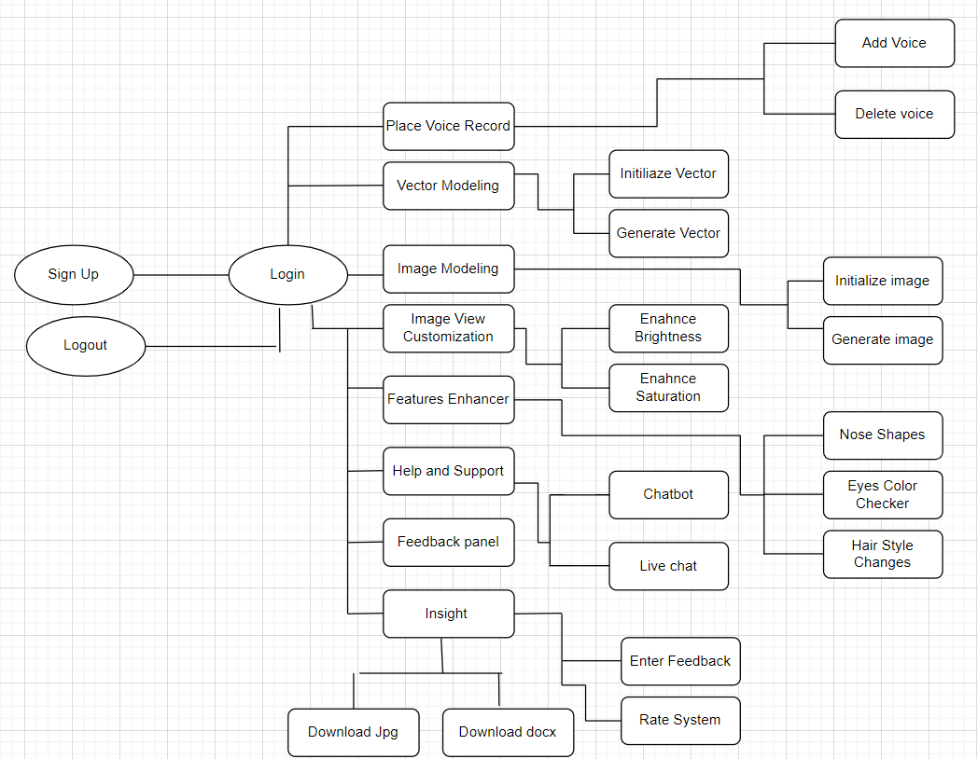
Process Flow Diagram of Proposed Project
The process flow diagram is as follows:
Figure-1: Process Flow Diagram – System Interaction For User.

Slide 13
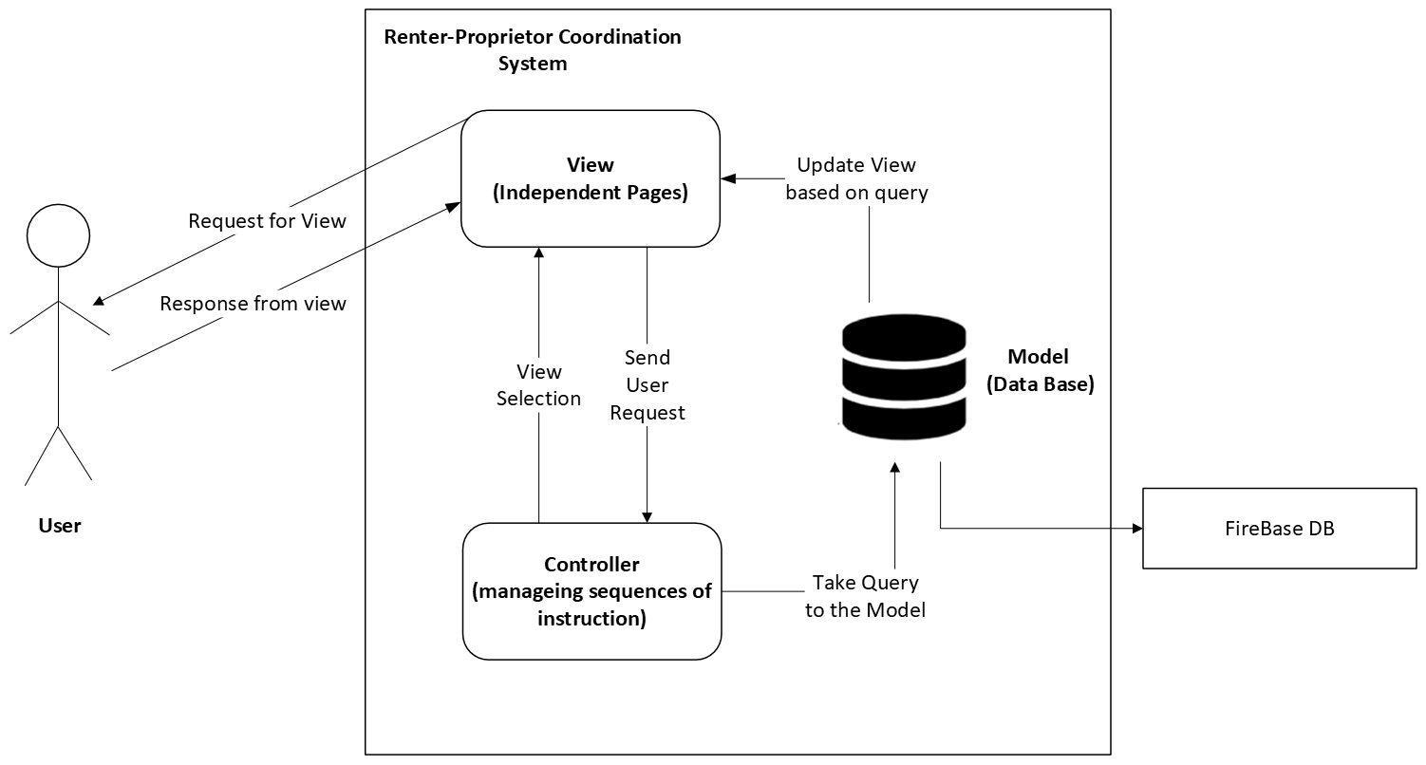
Architecture Diagram of Proposed Project
The Architecture style we are using will be Model View Controller (MVC).
Figure-2: MVC Architecture Diagram

Slide 14
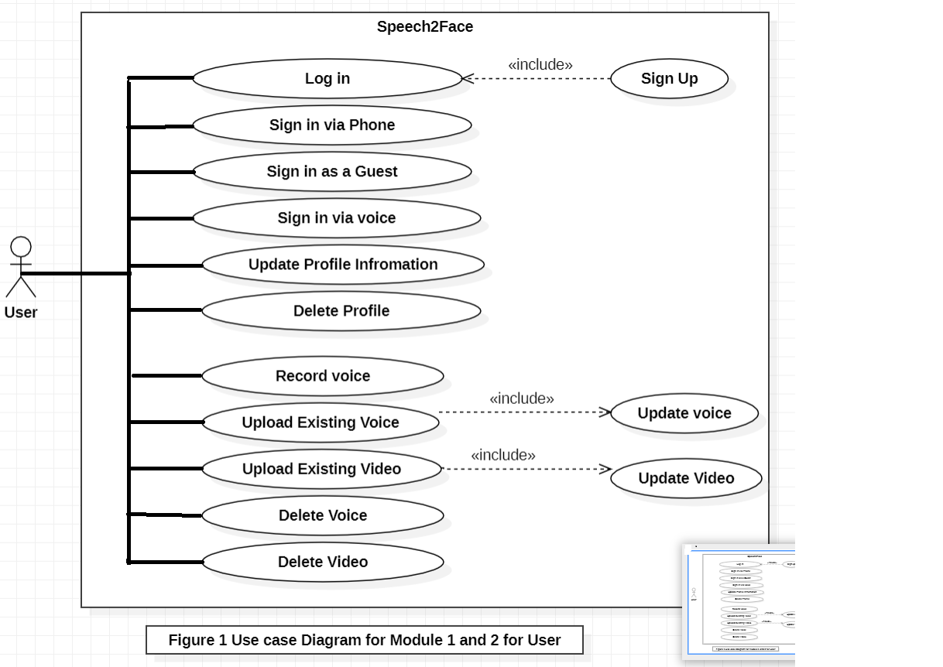
Use Case Diagram

Slide 15
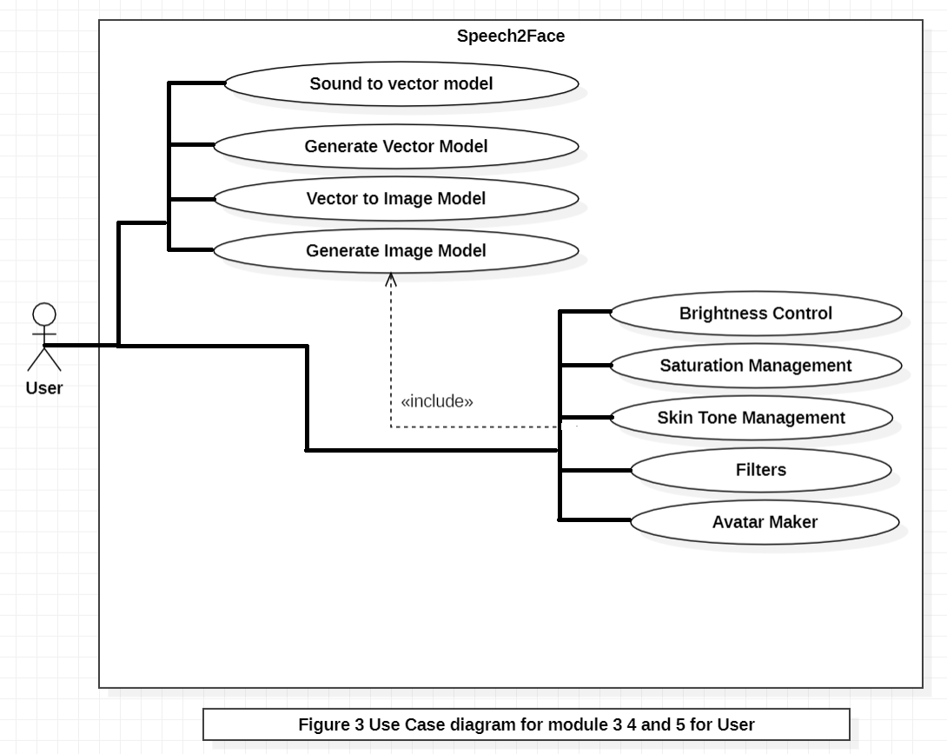
Use Case Diagram

Slide 16
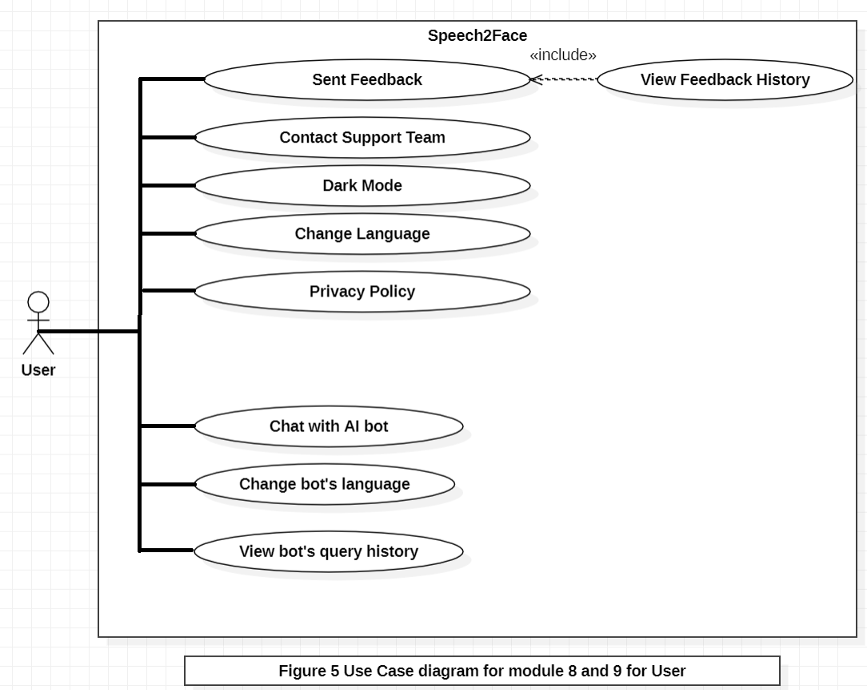
Use Case Diagram

Slide 17
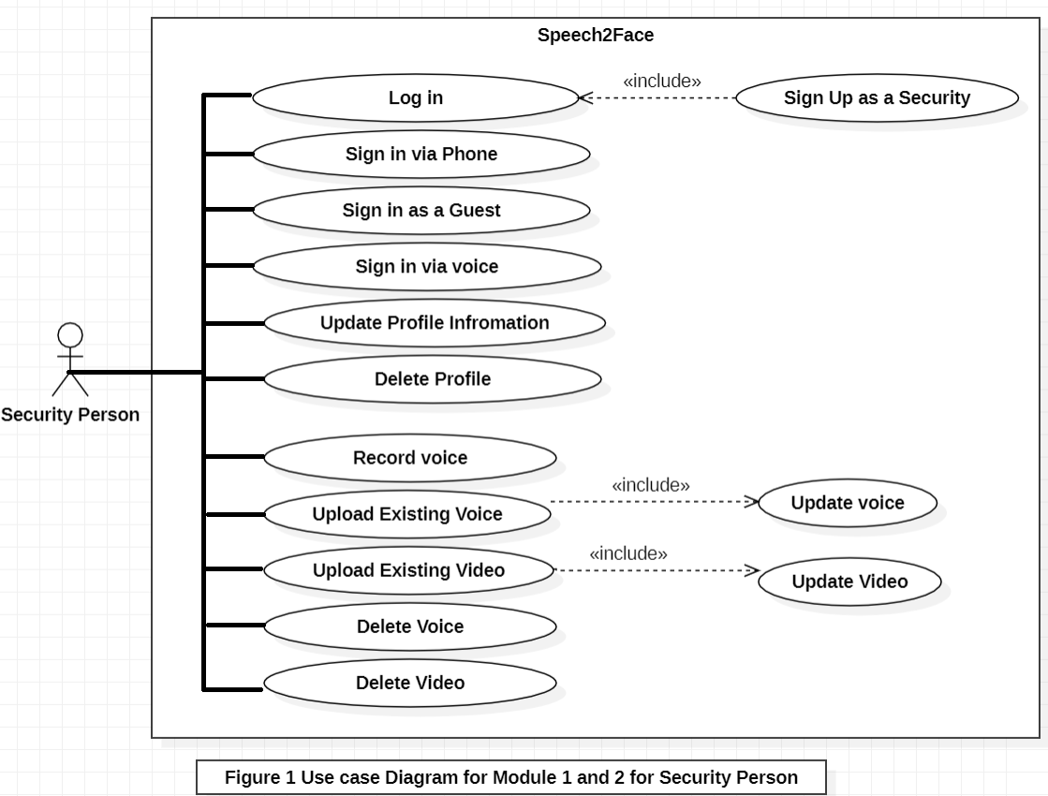
Use Case Diagram

Slide 18
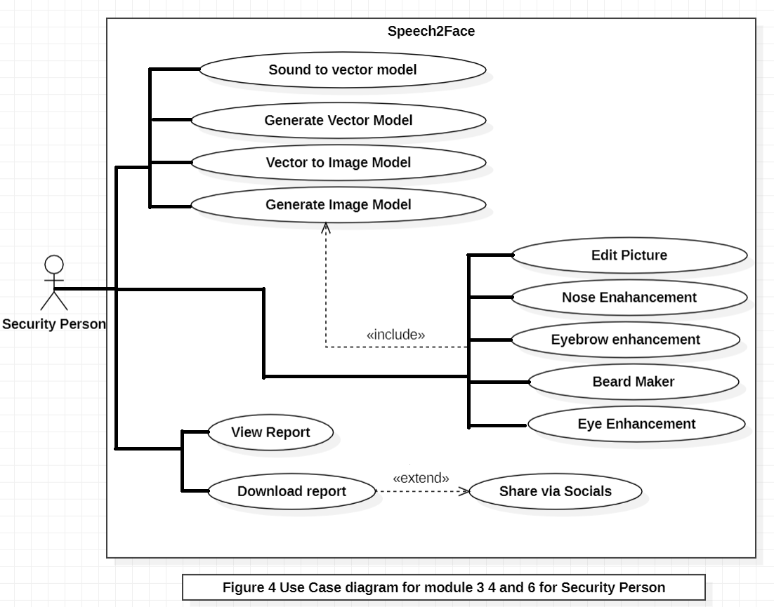
Use Case Diagram

Slide 19
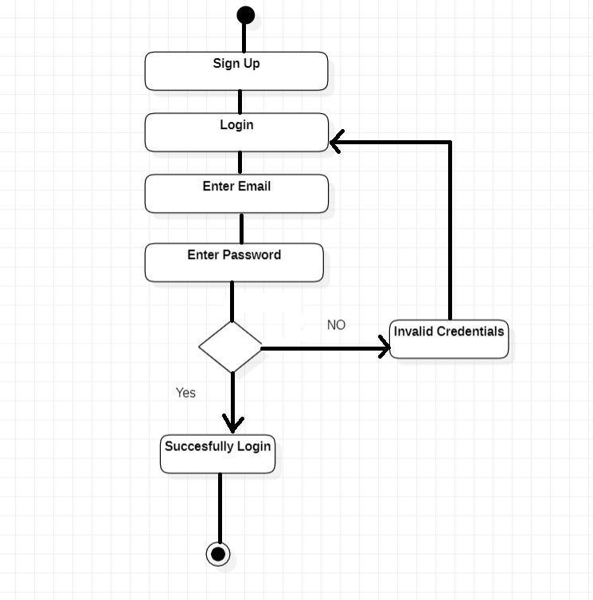
Activity Diagrams
Figure 1: Activity Diagram for Module 1

Slide 20
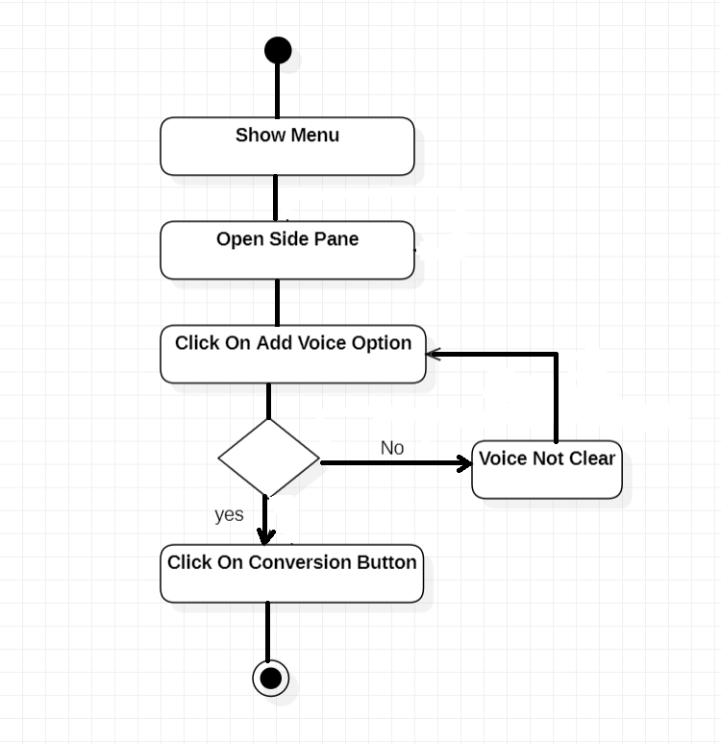
Activity Diagrams
Figure 2: Activity Diagram Module 2

Slide 21
Activity Diagrams
Figure 3: Activity Diagram of Payment Menu

Slide 22
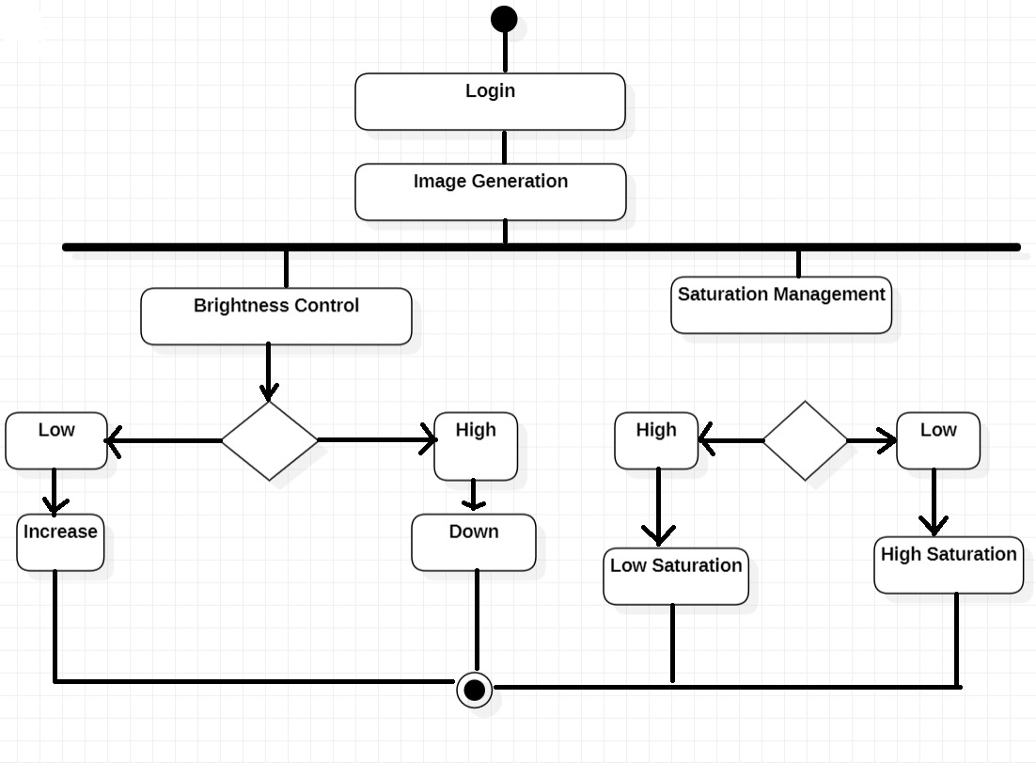
Activity Diagrams
Figure 4 : Activity Diagram of Module 5

Slide 23
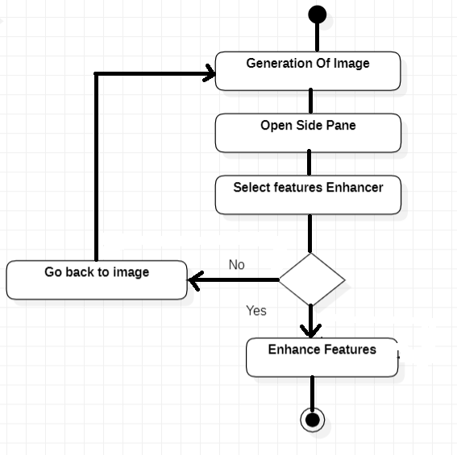
Activity Diagrams
Figure 5: Activity Diagram of Module 6

Slide 24
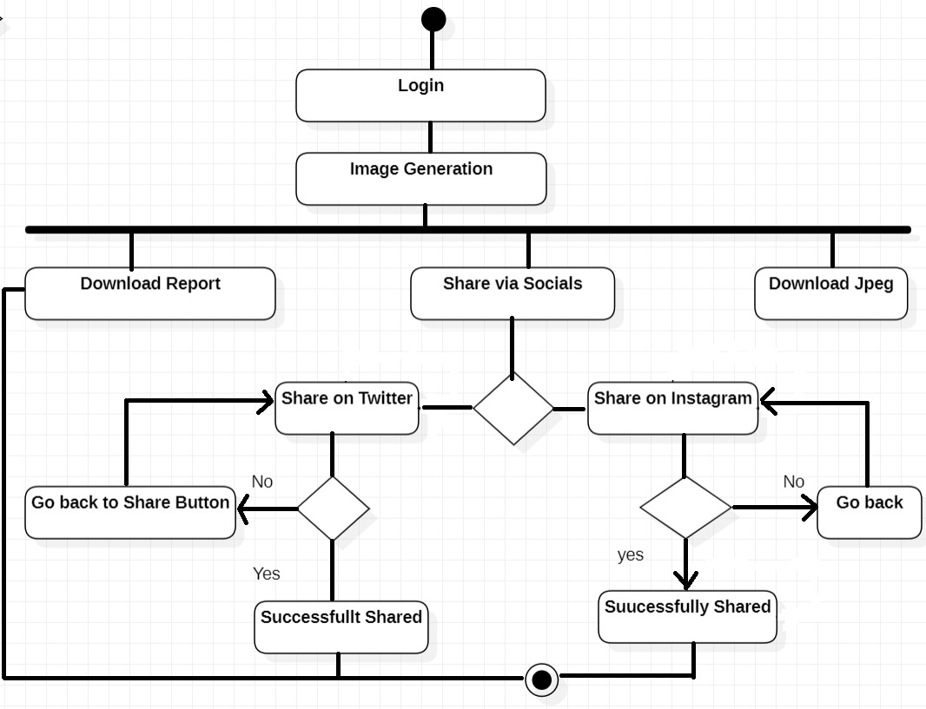
Activity Diagrams
Figure 5: Activity Diagram of Module 7

Slide 25
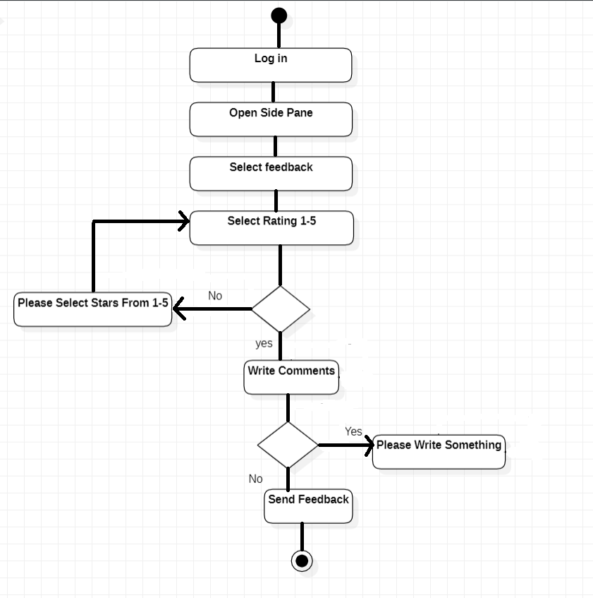
Activity Diagrams
Figure 5: Activity Diagram of Module 8

Slide 26
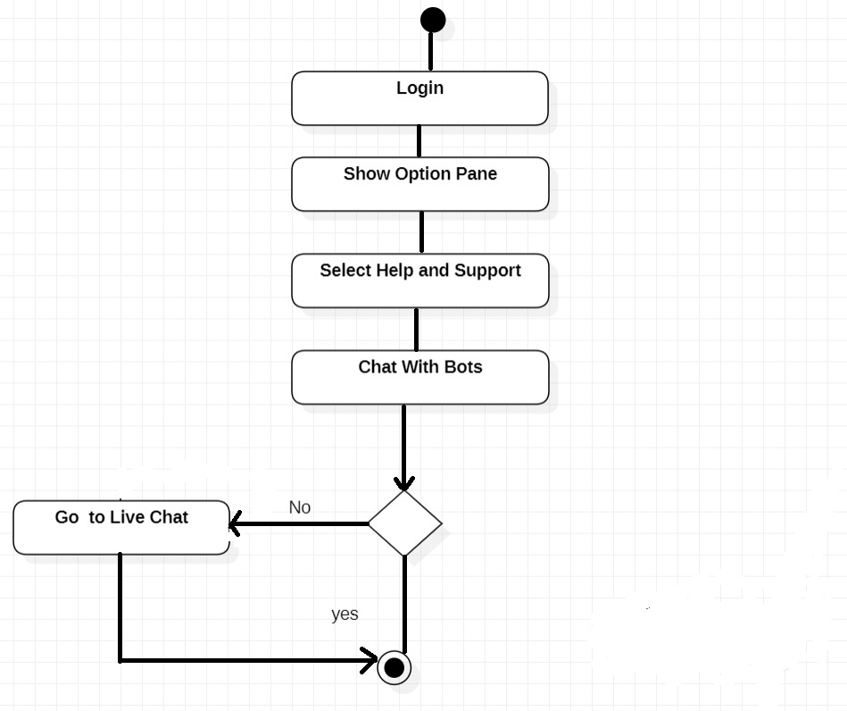
Activity Diagrams
Figure 5: Activity Diagram of Module 9

Slide 27
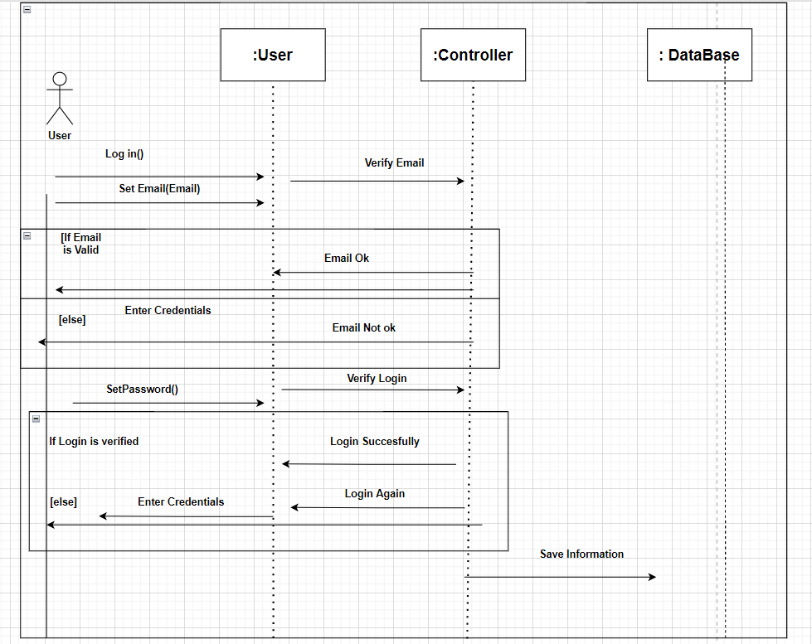
Sequence Diagram
Figure 1: Sequence Diagram of Module 1

Slide 28
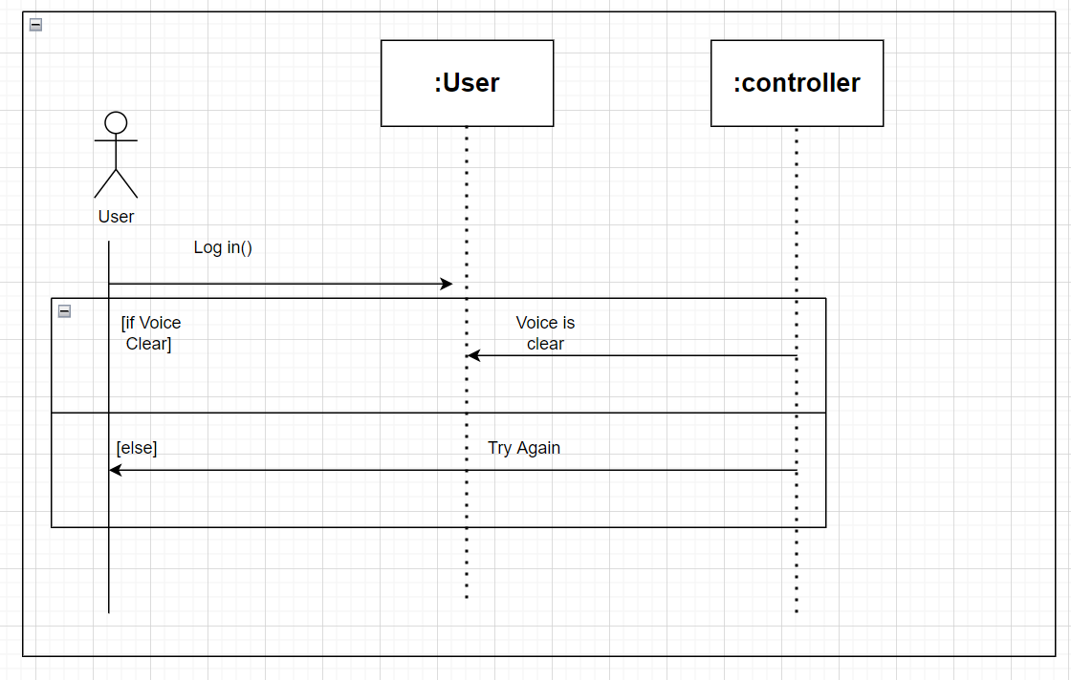
Sequence Diagram
Figure 2: Sequence Diagram of Module 2

Slide 29
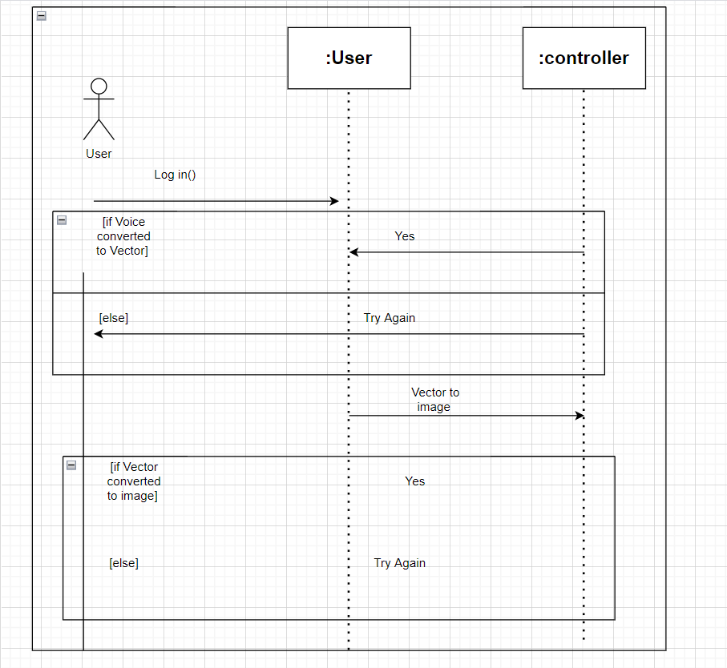
Sequence Diagram
Figure 3: Sequence Diagram of Module 3 and 4

Slide 30
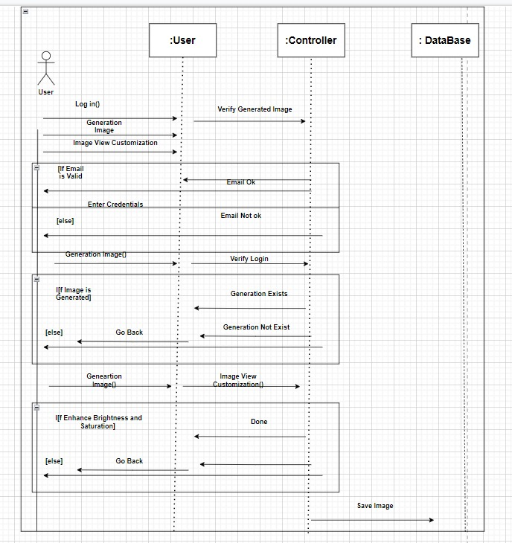
Sequence Diagram
Figure 4: Sequence Diagram of Module 5

Slide 31
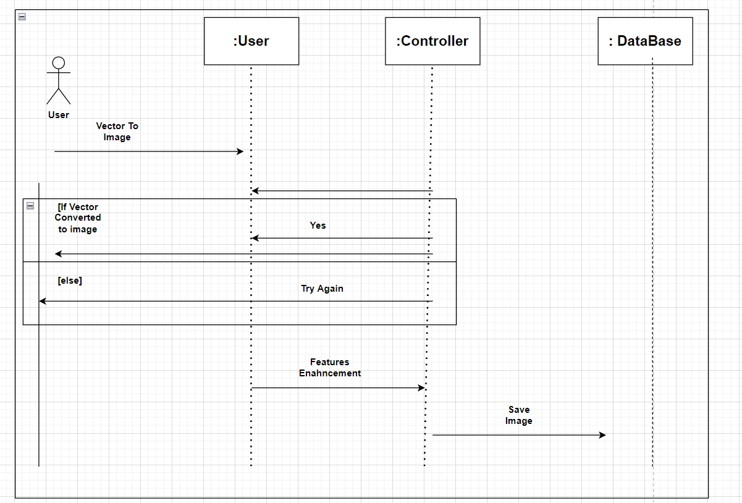
Sequence Diagram
Figure 5: Sequence Diagram of Module 6

Slide 32
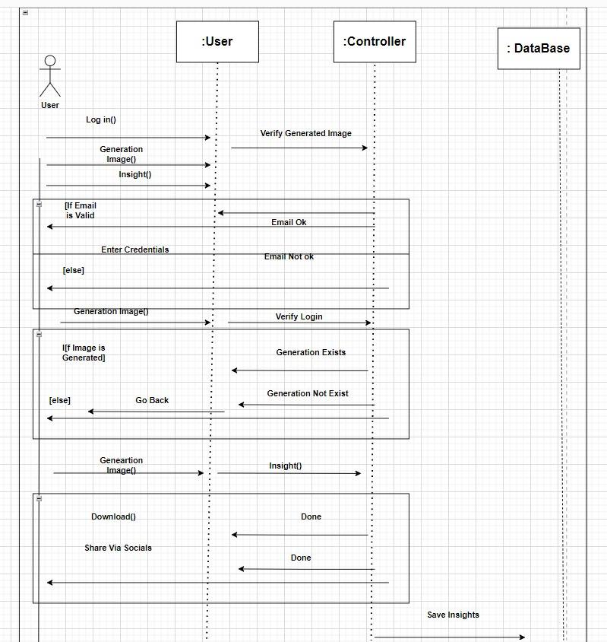
Sequence Diagram
Figure 6: Sequence Diagram of Module 7

Slide 33
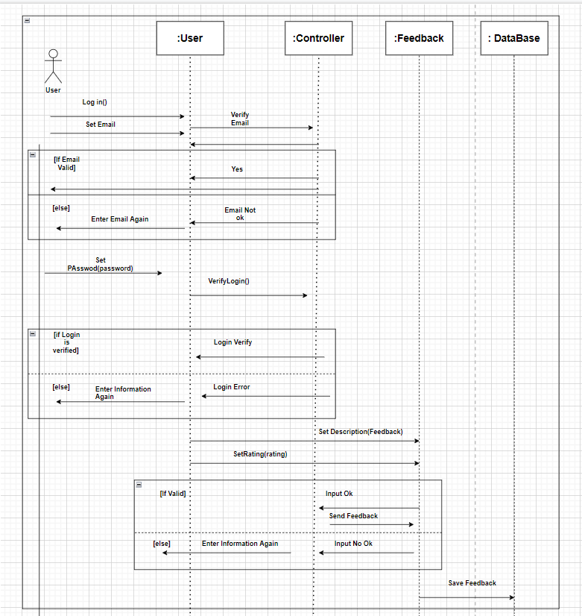
Sequence Diagram
Figure 7: Sequence Diagram of Module 8

Slide 34
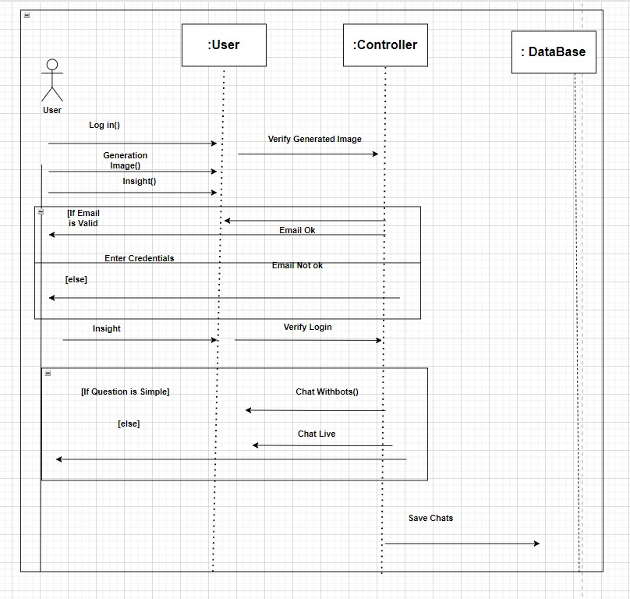
Sequence Diagram
Figure 8: Sequence Diagram of Module 9

Slide 35
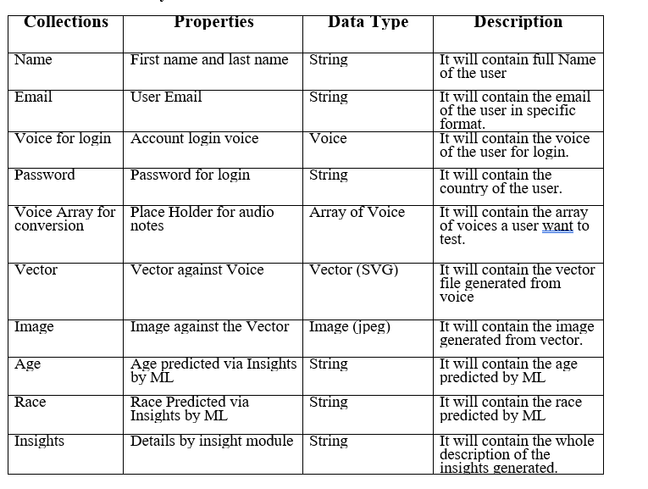
Data Design

Slide 36
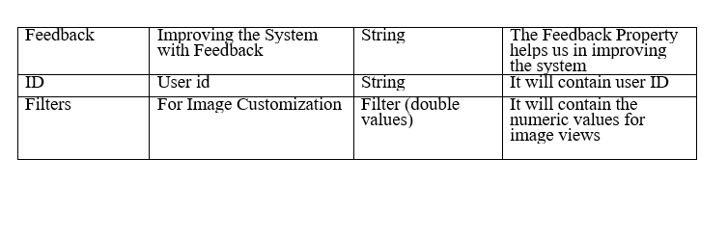
Data Design

Slide 37
Algorithm & Implementation
1) Sign up and Login
DO
INPUT email
IF(verifyEmail NOT EQUAL true)
DISPLAY “Invalid Email”
WHILE (verifyEmail EQUAL false)
INPUT password
IF(account NOT found)
DISPLAY “Invalid login credentials! Please try again!”
ELSE
DISPLAY “Successfully logged in!”
2) Adding Voice Record
IF(login)
DO
INPUT Voice Record
INPUT User Id
if(voice Not deleted)
Display”Voice saved”

Slide 38
Algorithm & Implementation
3) Voice to Vector Modeling
If(login && voiceSaved)
Initialize Vector Modeling
While(!Modeling Successful)
Initialize Again
I
Else
Generate Vector)
4) Vector to Image Modeling
If(login && voiceSaved)
Initialize Vector Modeling
While(!Modeling Successful)
Initialize Again
I
Else
Generate Vector)

Slide 39
Algorithm & Implementation
Vector to Image Modeling
IF (Login && VectorIsSaved)
InitialzeImageModeling
WHILE(!Modeling successful)
Initialize Again
ELSE
GENERATE Image
DISPLAY “Image Saved”

Slide 40
Algorithm & Implementation
Vector to Image Modeling
IF (Login && VectorIsSaved)
InitialzeImageModeling
WHILE(!Modeling successful)
Initialize Again
ELSE
GENERATE Image
DISPLAY “Image Saved”
Image View Customization
IF (Login && ImageSaved)
ShowCutomizeButton
IF(CustomizedButtonClicked)
ShowCustomizeScreen
WHILE(Brightness || saturation || hue)
setController;
MODIFY Image
DISPLAY Image

Slide 41
Algorithm & Implementation
Features Enhancer
IF(login && ImageGenerated)
ShowFeaturesEnhancer
SELECT NOSE , EYE, HAIR , SKIN COLOR
WHILE (NOSE || EYE || HAIR || SKIN is Modifying)
setController;
MODIFY Image
DISPLAY Image
Insight Panel
IF(login && ImageGenerated)
ShowInsightsPanel
SELECT (Download via JPG || DOCX || Share via socials)
ExecuteSelectedCommand

Slide 42
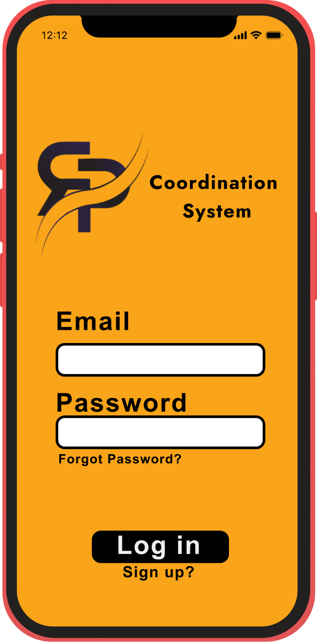
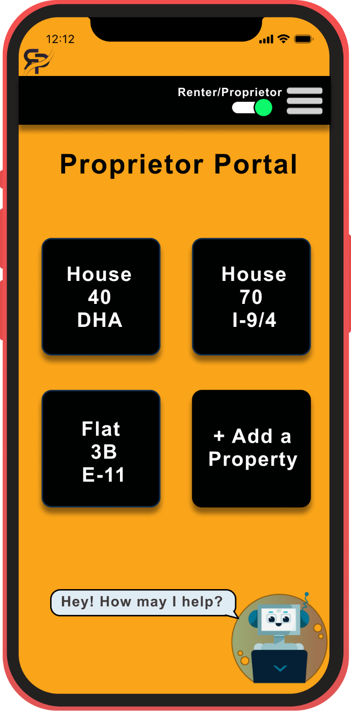
Human Computer Design
Figure 18: Screen Mockup of Logging in
Figure 19: Screen Mockup of Proprietor

Slide 43
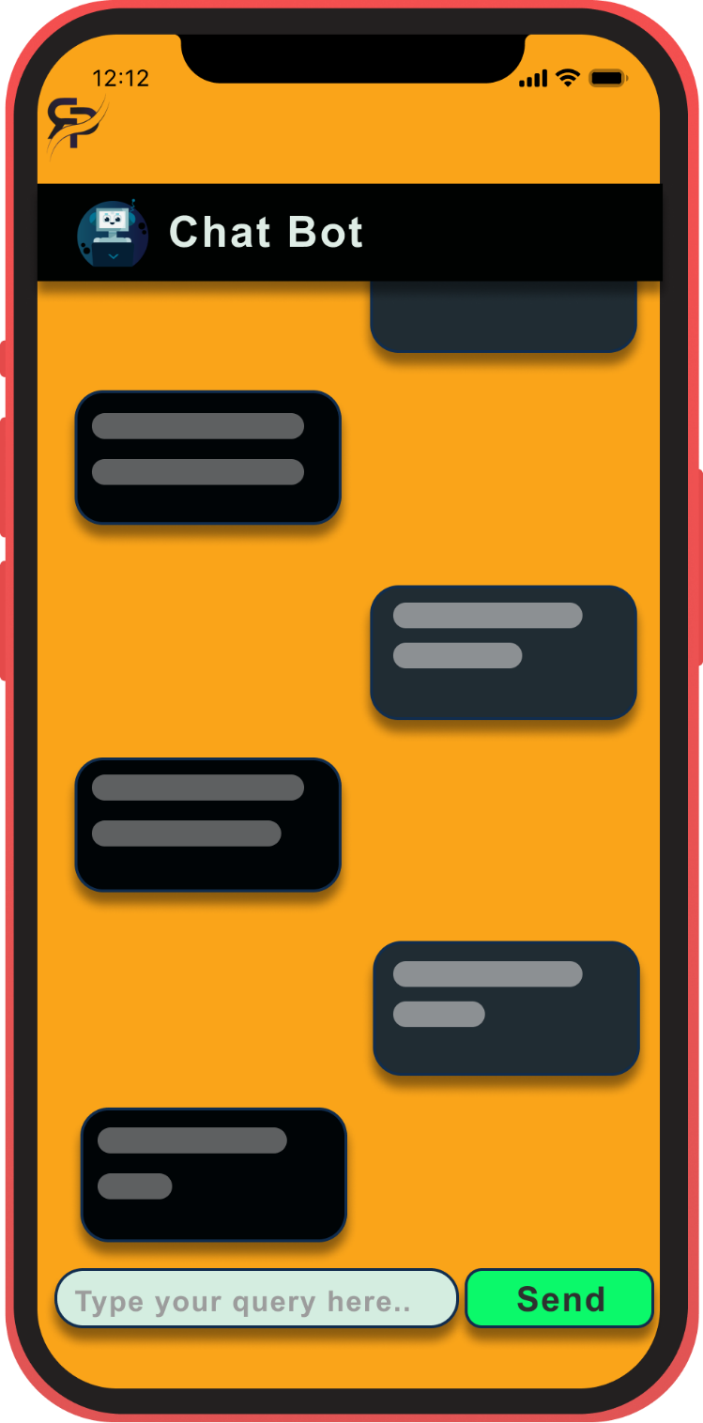
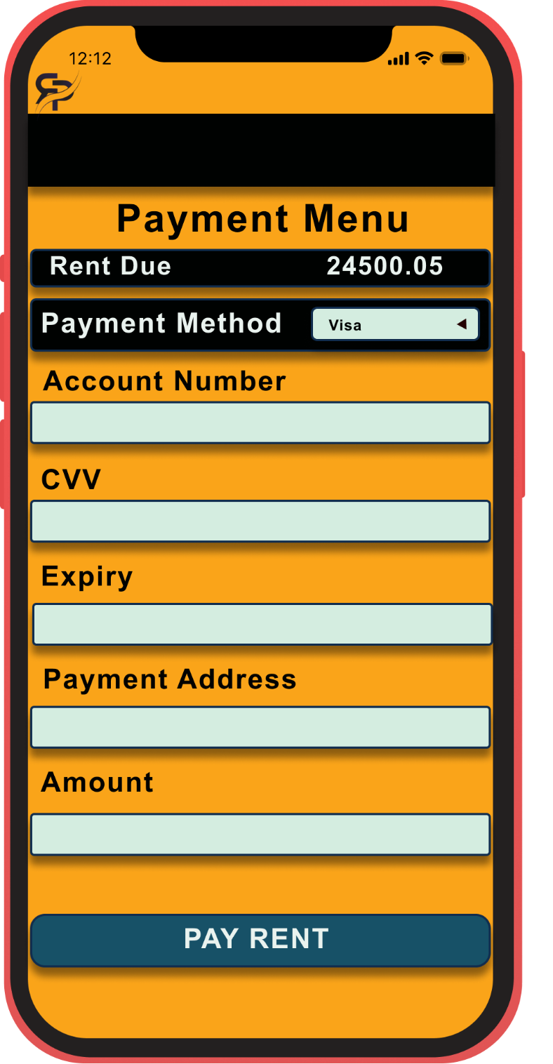
Human Computer Design
Figure 20: Screen Mockup of Chat with Bot
Figure 21: Screen Mockup of Payment

Slide 44
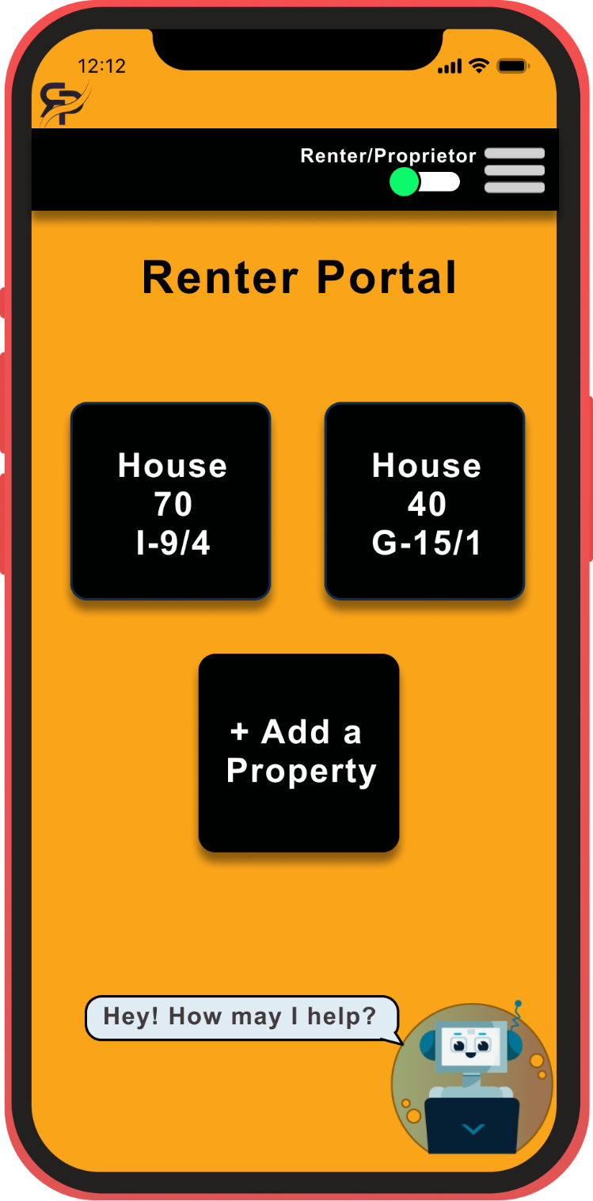
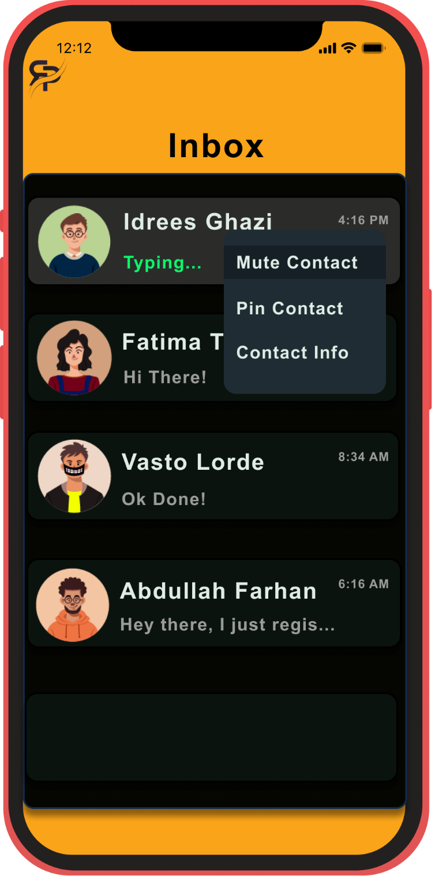
Human Computer Design
Figure 22: Screen Mockup of Renter Portal
Figure 23: Screen Mockup of Inbox (Muting)

Slide 45
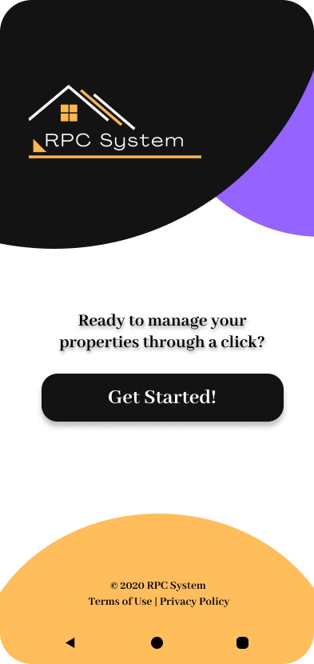
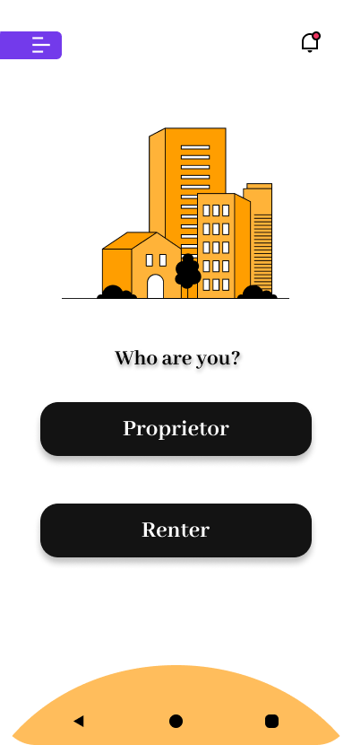
User Interfaces
Figure 24: User Interface of Starting Screen
Figure 25: User Interface of Role Selection

Slide 46
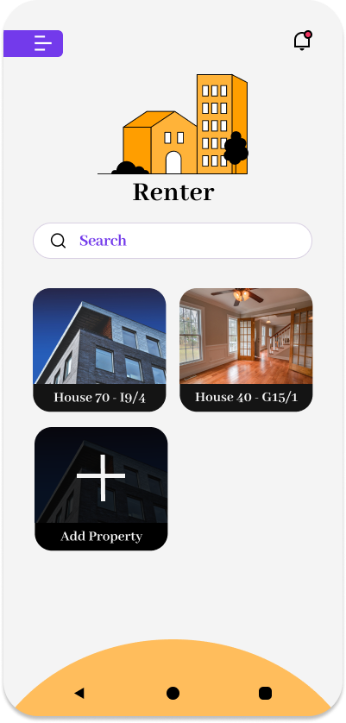
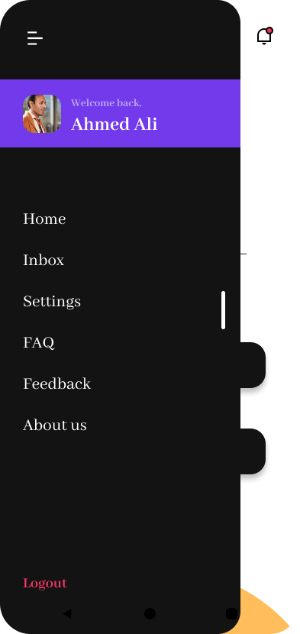
User Interfaces
Figure 26: User Interface of Renter Menu
Figure 27: User Interface of Side Menu

Slide 47
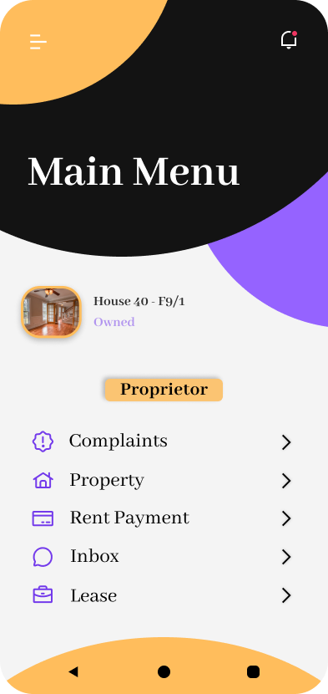
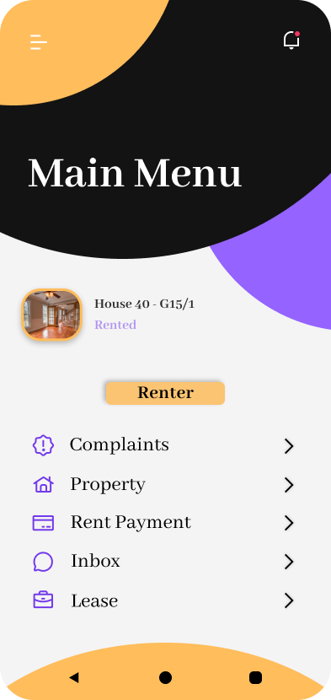
User Interfaces
Figure 28: User Interface of Proprietor Main Menu
Figure 29: User Interface of Renter Main Menu

Slide 48
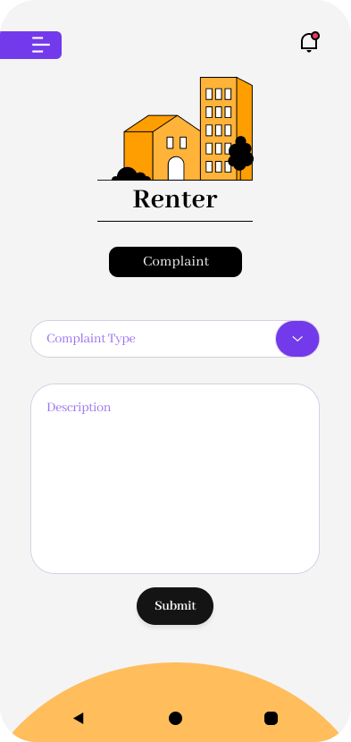
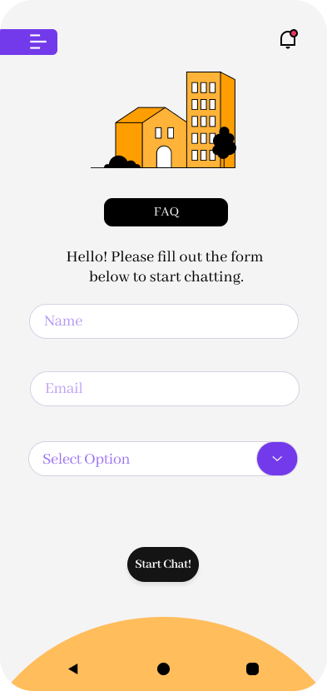
User Interfaces
Figure 30: User Interface of Renter Complaint Menu
Figure 31: User Interface of FAQ Menu

Slide 49
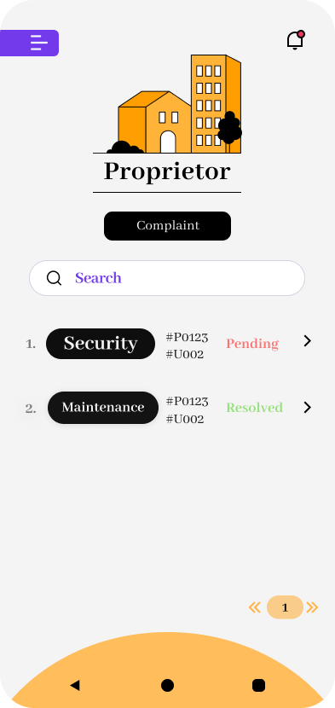
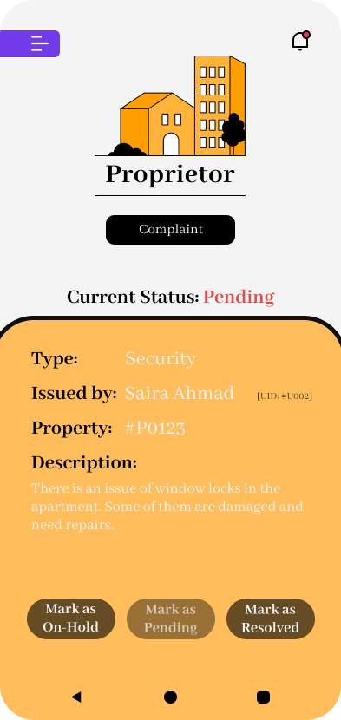
User Interfaces
Figure 32: User Interface of Complaint List
Figure 33: User Interface of Complaint Status

Slide 50
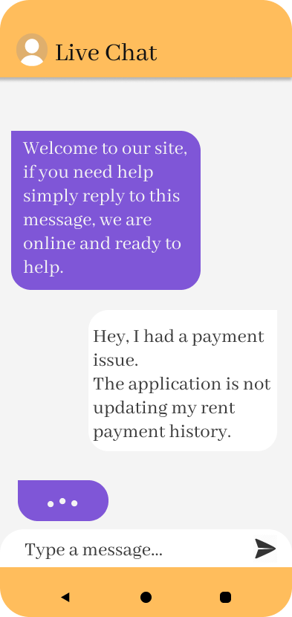
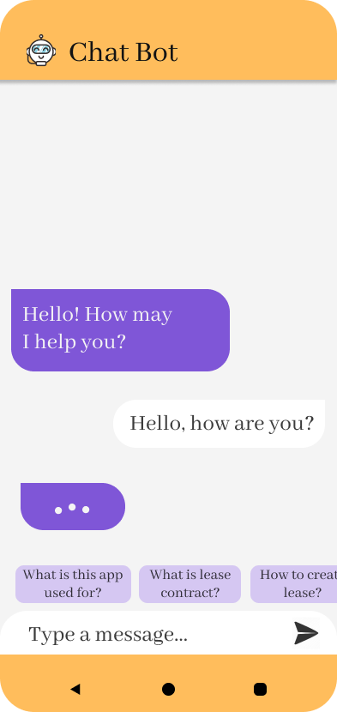
User Interfaces
Figure 34: User Interface of Live Chat
Figure 35: User Interface of Chat Bot

Slide 51
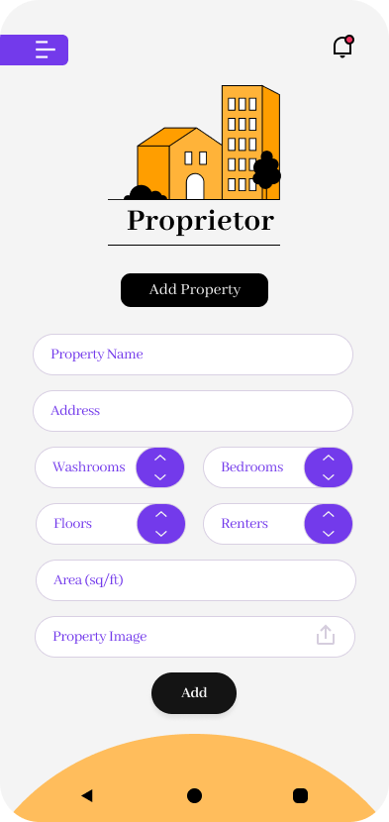
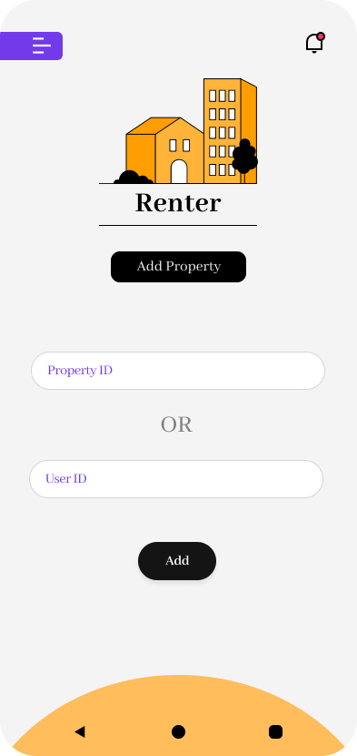
User Interfaces
Figure 36: User Interface of Add Property Menu (Proprietor)
Figure 37: User Interface of Add Property Menu (Renter)

Slide 52
Conclusion
In this presentation:
The scope of the project is stated with modules of the system described in detail.
The Architecture style used is also explained with diagram.
The Data Design of the System is explained.
The Activity Diagrams of use cases are described.
The Class diagram of the system is provided using which sequence diagrams of use cases are created.
Entity Relation Diagram is presented.
The Data Design of the System is explained alphabetically.
The Algorithm and implantation pseudo codes are described in detail.
Human Computer design and all the elements of UI are shown in the form of mockups.

Slide 53
References
• Renting problems. (2020, September 11). Housing Advice NI. https://www.housingadviceni.org/advice-young-people/renting-problems
• Complete this 10-item checklist before Tenant move in. (2013, October 22). The Balance Small Business. https://www.thebalancesmb.com/landlord-actions-before-move-in-2125027

Slide 54
Plagarism Report

Slide 55

Questions and Answers

